Slide 1
Retrieving data

Slide 2
Learning Goals
In this section, we will cover:
- Retrieving data from multiple data sources:
• SQL databases
• NoSQL databases
• APIs
• Cloud data sources
- Understand common issues that arise with importing data

Slide 3
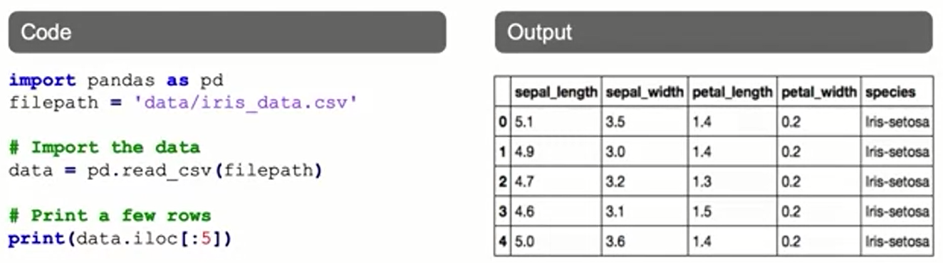
Reading CSV Files
Comma-separated (CSV) files consist of rows of data, separated by commas.
In Pandas, CSV files can typically be read using just a few lines of code:

Slide 4
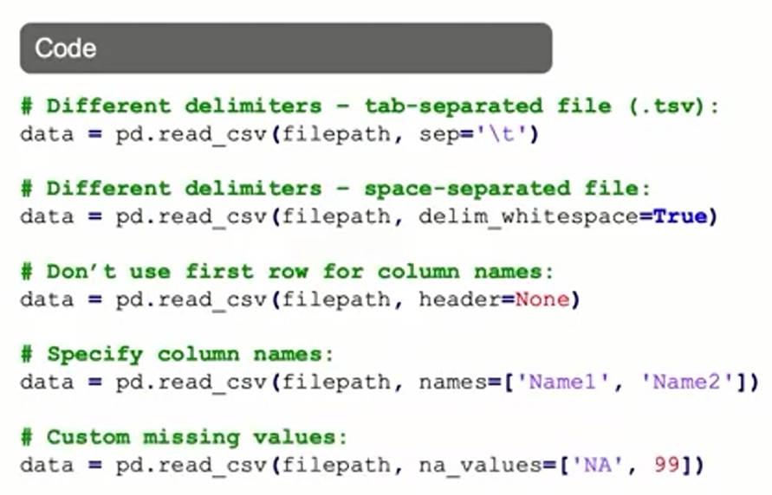
Reading CSV Files: Useful Arguments

Slide 5
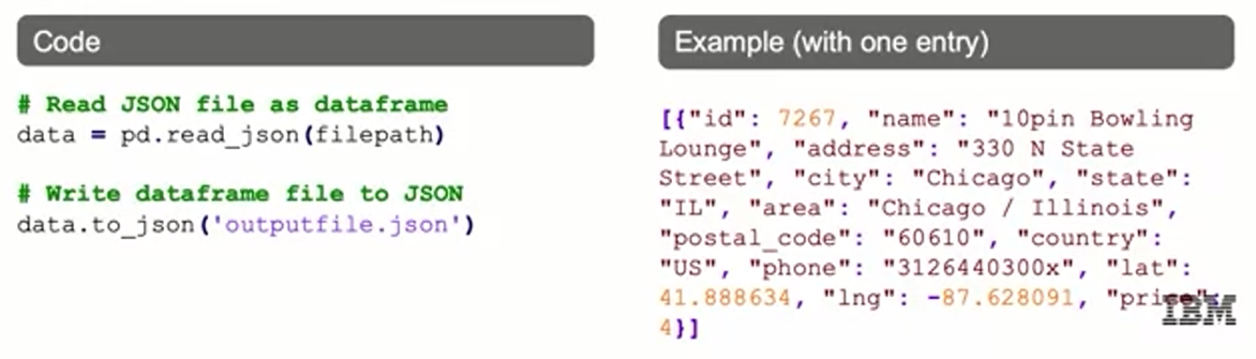
JSON Files
JavaScript Object Notation (JSON) files are a standard way to store data across platforms.
JSON files are very similar in structure to Python dictionaries.
Reading JSON files into Python:
“price”

Slide 6
SQL Databases
Structured Query Language (SQL) represents a set of relational databases with fixed schemas.
There are many types of SQL databases, which function similarly (with some subtle differences in syntax).
Examples of SQL databases:
- Microsoft SQL Server
- Postgres
- MySQL
- AWS Redshift
- Oracle DB
- Db2 Family

Slide 7
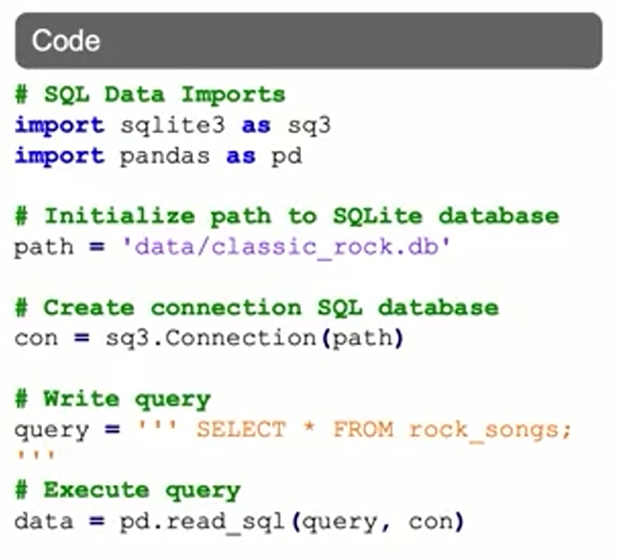
Reading SQL Data
While this example uses sqlite3, there are several other packages available.
The SQL module creates a connection with the database.
Data is read into pandas by combining a query with this connection.

Slide 8
NoSQL Databases
Not-only SQL (NoSQL) databases are not relational, vary more in structure.
Depending on application, may perform more quickly or reduce technical overhead.
Most NoSQL databases store data in JSON format.
Examples of NoSQL databases:
- Document databases: mongoDB, couchDB
- Key-value stores: Riak, Voldemort, Redis
- Graph databases: Neo4j, HyperGraph
- Wide-column stores: Cassandra, HBase

Slide 9
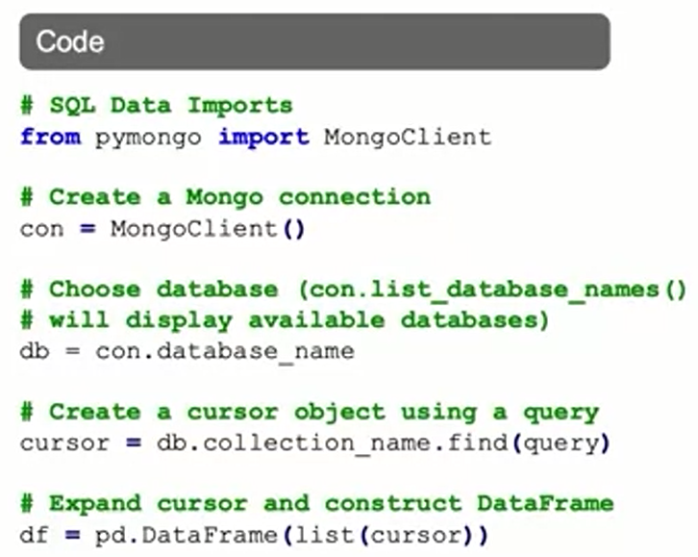
Reading NoSQL Data
This example uses the pymongo module to read files stored in MongoDB, although there are several other packages available.
We first make a connection with the database (MongoDB needs to be running).
Data is read into pandas by combining a query with this connection.
Here, query should be replaced with a MongoDB query string (or { } to select all).

Slide 10
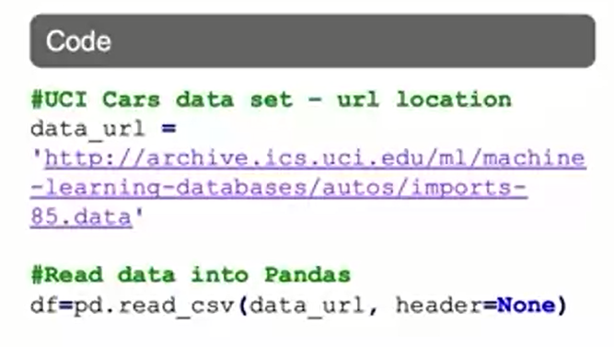
APls and Cloud Data Access
A variety of data providers make data available via Application Programming Interfaces (APIs), that makes it easy to access such data via Python.
There are also a number of datasets available online in various formats.
An online available example is the UC Irvine Machine Learning Library.
Here, we read one of its datasets into Pandas directly via the URL.

Slide 11
Summary
Reading in Database Files
The steps to read in a database file using the sqlite library are:
create a path variable that references the path to your database
create a connection variable that references the connection to your database
create a query variable that contains the SQL query that reads in the data table from your database
create an observations variable to assign the read_sql functions from pandas package
create a tables variable to read in the data from the table sqlite_master
JSON files are a standard way to store data across platforms. Their structure is similar to Python dictionaries.
NoSQL databases are not relational and vary more in structure. Most NoSQL databases store data in JSON format.

Slide 12
Learning Recap
In this section, we discussed:
- Retrieving data from multiple data sources:
• SQL databases
• NoSQL databases
• APIs
• Cloud data sources
- Understand common issues that arise with importing data

Slide 13
Cleaning data

Slide 14
Learning Goals
In this section, we will cover:
- Why data cleaning is important for Machine Learning
- Issues that arise with messy data
- How to identify duplicate or unnecessary data
- Policies for dealing with outliers

Slide 15
Why is Data Cleaning so Important?
Decisions and analytics are increasingly driven by data and models.
Key aspects of Machine Learning Workflow depend on cleaned data:
- Observations: An instance of the data (usually a point or row in a dataset)
- Labels: Output variable(s) being predicted
- Algorithms: Computer programs that estimate models based on available data
- Features: Information we have for each observation (variables)
- Model: Hypothesized relationship between observations and data
Messy data can lead to “garbage-in, garbage-out" effect, and unreliable outcomes.

Slide 16
Why is Data Cleaning so Important?
The main data problems companies face:
- Lack of data
- Too much data
- Bad data
Having data ready for ML and Al ensures you are ready to infuse Al across your organization.

Slide 17
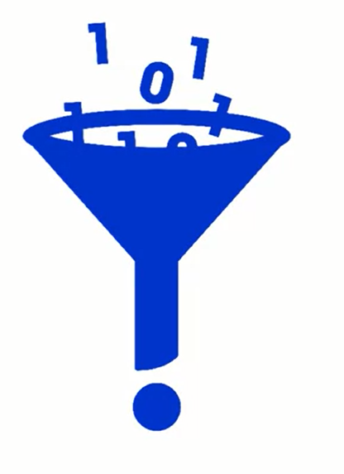
How Can Data be Messy?
- Duplicate or unnecessary data
- Inconsistent text and typos
- Missing data
- Outliers
Data sourcing issues:
- Multiple systems
- Different database types
- On premises, in cloud
- ... and more.

Slide 18
Duplicate or Unnecessary Data
Pay attention to duplicate values and research why there are multiple values.
Duplicate entries are problematic for multiple reasons. An entry appearing more than once receives disproportionate weight during training. Models that succeed on frequent entries only look like they perform well.
Duplicate entries can ruin the split between train, validation, and test sets where identical entries are not all in the same set. This can lead to biased performance estimates that result in disappointing the model in production.

Slide 19
Duplicate or Unnecessary Data
There are many possible causes for duplicate entries in databases, such as processing steps that were rerun anywhere in the data pipeline. While the existence of duplicates hurt the learning process greatly, it is relatively easy to fix.
One option is to enforce columns to be unique whenever applicable.
Another is to run a script to automatically detect and delete duplicate entries. This can be done easily with Pandas’ drop_duplicates functionality shown in the next slide.
Refer to https://pandas.pydata.org/docs/reference/frame.html

Slide 20
Duplicate or Unnecessary Data
df FirstName LastName PhoneNo 0 A B 1 1 A B 1 2 A B 2 df.drop_duplicates(subset=["FirstName", "LastName"]) FirstName LastName PhoneNo 0 A B 1
Consider dataset containing ramen rating:
>>> df = pd.DataFrame({
... 'brand': ['Yum Yum', 'Yum Yum', 'Indomie', 'Indomie', 'Indomie'],
... 'style': ['cup', 'cup', 'cup', 'pack', 'pack'],
... 'rating': [4, 4, 3.5, 15, 5]
... })
>>> df
brand style rating
0 Yum Yum cup 4.0
1 Yum Yum cup 4.0
2 Indomie cup 3.5
3 Indomie pack 15.0
4 Indomie pack 5.0

Slide 21
Duplicate or Unnecessary Data
By default, it removes duplicate rows based on all columns.:
To remove duplicates on specific column(s), use subset:
>>> df.drop_duplicates()
brand style rating
0 Yum Yum cup 4.0
2 Indomie cup 3.5
3 Indomie pack 15.0
4 Indomie pack 5.0
>>> df.drop_duplicates(subset=['brand'])
brand style rating
0 Yum Yum cup 4.0
2 Indomie cup 3.5

Slide 22
Duplicate or Unnecessary Data
Unnecessary values can slow down the data analysis process and distract you from achieving certain goals
Other elements you’ll need to remove as they add nothing to your data include:
Personal identifiable (PII) data
URLs
HTML tags
Boilerplate text (for ex. in emails)
Tracking codes
Excessive blank space between text
It's a good idea to look at the features you're bringing in and filter the data as necessary (be careful not to filter too much if you may use features later).
Refer to https://pandas.pydata.org/docs/reference/frame.html

Slide 23
Duplicate or Unnecessary Data
How to filter:
>>> df = pd.DataFrame(np.array(([1, 2, 3], [4, 5, 6])),
... index=['mouse', 'rabbit'],
... columns=['one', 'two', 'three'])
>>> df
one two three
mouse 1 2 3
rabbit 4 5 6
>>> # select columns by name
>>> df.filter(items=['one', 'three'])
one three
mouse 1 3
rabbit 4 6

Slide 24
Duplicate or Unnecessary Data
How to filter:
>>> # select columns by regular expression
>>> df.filter(regex='e$', axis=1)
one three
mouse 1 3
rabbit 4 6
>>> # select rows containing 'bbi'
>>> df.filter(like='bbi', axis=0)
one two three
rabbit 4 5 6

Slide 25
Duplicate or Unnecessary Data
How to remove data:
Drop columns:
>>> df = pd.DataFrame(np.arange(12).reshape(3, 4),
... columns=['A', 'B', 'C', 'D'])
>>> df
A B C D
0 0 1 2 3
1 4 5 6 7
2 8 9 10 11
>>> df.drop(['B', 'C'], axis=1)
A D
0 0 3
1 4 7
2 8 11

Slide 26
Policies for Missing Data
Remove the data: remove the row(s) entirely.
Impute the data: replace with substituted values. Fill in the missing data with the most common value, the average value, etc.
Mask the data: create a category for missing values.
What are the pros and cons of each of these approaches?

Slide 27
Outliers
An outlier is an observation in data that is distant from most other observations.
Typically, these observations are aberrations and do not accurately represent the phenomenon we are trying to explain through the model.
If we do not identify and deal with outliers, they can have a significant impact on the model.
It is important to remember that some outliers are informative and provide insights into the data.

Slide 28
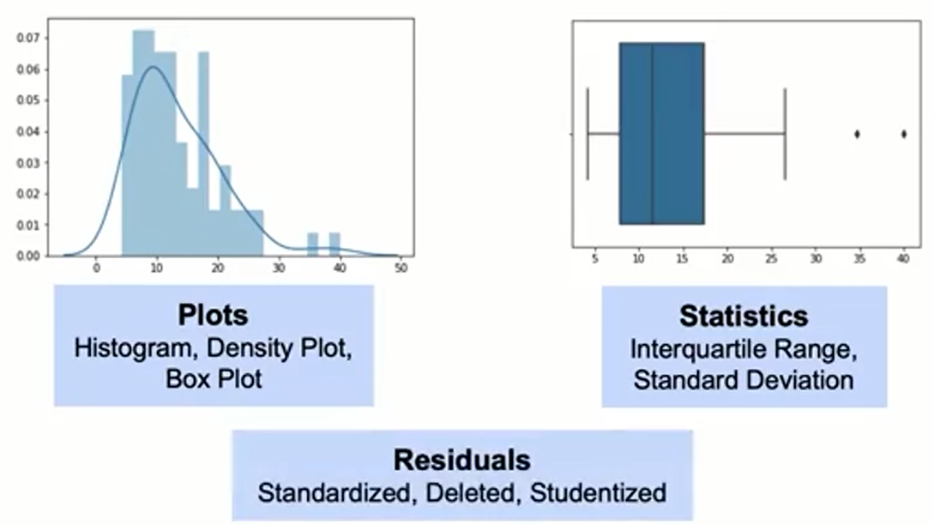
How to Find Outliers?

Slide 29
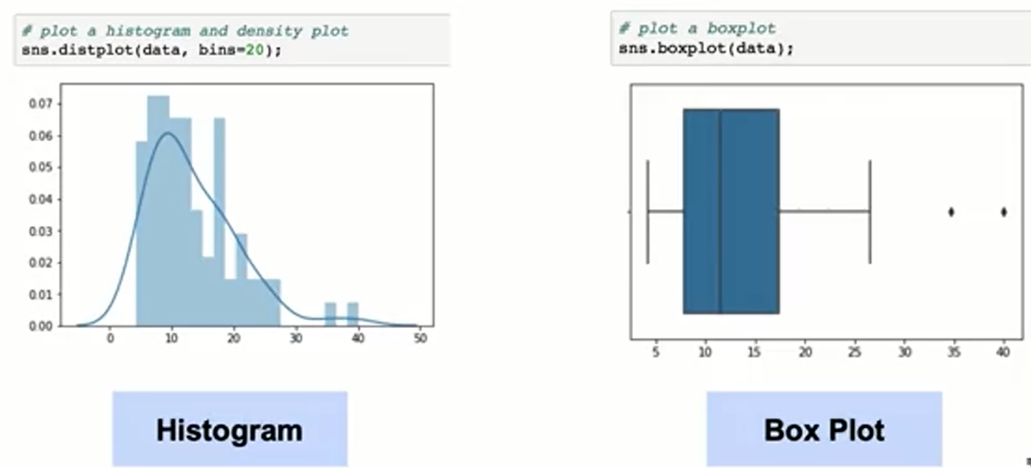
Detecting Outliers: Plots

Slide 30
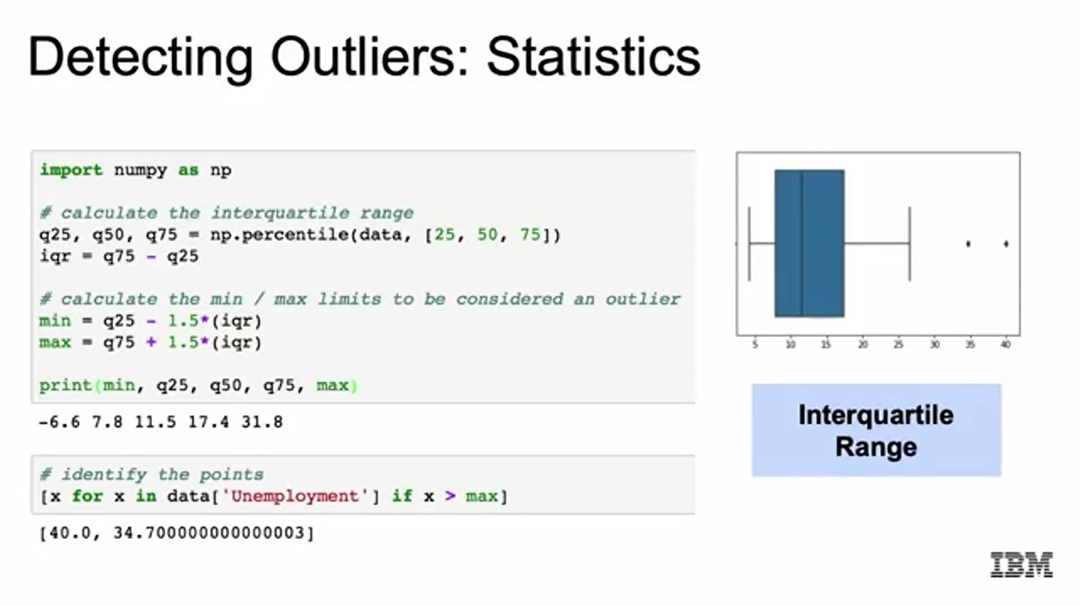
Detecting Outliers: Statistics

Slide 31
Detecting Outliers: Residuals
Residuals (differences between actual and predicted values of the outcome variable) represent model failure.
Approaches to calculating residuals:
- Standardized: residual divided by standard error.
- Deleted: residual from fitting model on all data excluding current observation.
- Studentized: Deleted residuals divided by residual standard error (based on all data, or all data excluding current observation).

Slide 32
Policies for Outliers
Remove them.
Assign the mean or median value.
Transform the variable.
Predict the what the value should be:
- Using 'similar' observations to predict likely values.
- Using regression.
Keep them, but focus on models that are resistant to outliers.

Slide 33
Summary
Retrieving Data
You can retrieve data from multiple sources:
SQL databases
NoSQL databases
APIs
Cloud data sources
The two most common formats for delimited data flat files are comma separated (csv) and tab separated (tsv). It is also possible to use special characters as separators.
SQL represents a set of relational databases with fixed schemas.

Slide 34
Summary
Data Cleaning
Data Cleaning is important because messy data will lead to unreliable outcomes. Some common issues that make data messy are: duplicate or unnecessary data, inconsistent data and typos, missing data, outliers, and data source issues.
You can identify duplicate or unnecessary dataCommon policies to deal with missing data are: remove a row with missing columns, impute the missing data, and mask the data by creating a category for missing values.
Common methods to find outliers are: through plots, statistics, or residuals.
Common policies to deal with outliers are: remove outliers, impute them, use a variable transformation, or use a model that is resistant to outliers.

Slide 35
Learning Recap
In this section, we discussed:
- Why data cleaning is important for Machine Learning
- Issues that arise with messy data
- How to identify duplicate or unnecessary data
- Policies for dealing with outliers

